Slide 1



Digital Portfolio
STUDENT NAME: Govarthana Giri Raja S
REGISTER NO AND NMID:212400936 B842A3E2CD97F5194B443E2EAD8BBAE6
DEPARTMENT: Bachelor of Computer Applications
COLLEGE: COLLEGE/ UNIVERSITY : Prince Shri Venkateshwara Arts and Science College/Madras University
1
Notes:
1.7.2013
1.7.2013
1
‹#›
‹#›

Slide 2

PROJECT TITLE
This project focuses on Off-Page SEO, a crucial technique in digital marketing that enhances a website’s authority, trust, and visibility beyond its internal structure. Off-Page SEO strategies involve building strong backlinks, promoting content through external platforms, increasing brand mentions,
and engaging with online communities to drive organic traffic.
The project aims to study, design, and implement effective Off-Page SEO practices that improve search engine ranking, domain authority, and online presence. Through this title, the project emphasizes the importance of external factors in strengthening a website’s reputation and competitive edge in the digital world.
2

Slide 3



AGENDA
Problem Statement
Project Overview
End Users
Tools and Technologies
Portfolio design and Layout
Features and Functionality
Results and Screenshots
Conclusion
Github Link
3
3/21/2024 Annual Review

Slide 4

PROBLEM STATEMENT
In the digital era, having a well-structured and optimized website alone is not sufficient to achieve higher visibility in search engine results. While on-page SEO improves the technical and content-related aspects of a website, it does not fully address the challenge of building authority, credibility, and trust in the eyes of search engines.
4

Slide 5

PROJECT OVERVIEW
This project focuses on the implementation and analysis of Off-Page SEO techniques to enhance a website’s online presence, authority, and ranking in search engines. While on-page SEO ensures proper optimization within the website, off-page SEO strategies strengthen the site’s credibility and trustworthiness through external signals such as backlinks, social engagement, and brand mentions.
The project explores various off-page SEO practices, including link building, social bookmarking, directory submission, article posting, forum participation, influencer outreach, and social media promotion. These methods are aimed at increasing referral traffic, improving search engine rankings, and establishing a strong digital reputation for the brand
5

Slide 6

WHO ARE THE END USERS?
The end users of Off-Page SEO strategies are the businesses, organizations, and individuals who aim to improve their website’s visibility, credibility, and ranking on search engines. These users benefit from the traffic, brand awareness, and trust generated through external optimization efforts.
Key End Users:
Businesses and Companies
E-commerce websites, startups, and enterprises that need higher visibility to attract potential customers and increase sales.
Digital Marketers and SEO Professionals
Agencies and individuals who implement off-page SEO strategies on behalf of clients to boost online growth.
Content Creators and Bloggers
Writers, bloggers, and publishers who require external promotion to reach wider audiences.
6

Slide 7

TOOLS AND TECHNIQUES
Tools and Techniquues:
To successfully implement off-page SEO strategies, various tools and techniques are used. These help in monitoring backlinks, tracking performance, analyzing competitors, and improving outreach activities.
🔧 Tools Used in Off-Page SEO
Google Search Console
Tracks website performance in Google search results.
Monitors backlinks, impressions, and indexing status.
Ahrefs / SEMrush / Moz
Powerful SEO tools for backlink analysis, keyword research, and competitor monitoring.
Helps identify link-building opportunities.
Ubersuggest
Provides keyword ideas, backlink data, and site audit reports.
BuzzSumo
Identifies trending topics and popular content to support content marketing and outreach.
7

Slide 8
POTFOLIO DESIGN AND LAYOUT
The portfolio design and layout for the Off-Page SEO project is structured to present the work in a clear, professional, and well-organized format. A proper design ensures that each section of the report is easy to navigate and highlights the key outcomes of the project effectively.
Key Elements of the Portfolio Design
Cover Page
Title of the project (Off-Page SEO).
Student/Author name, course, and institution details.
Date of submission.
Table of Contents
A structured index of all sections (Problem Statement, Project Overview, Objectives, Tools & Techniques, End Users, Results, Conclusion).
Introduction Section
Brief description of SEO and the importance of Off-Page optimization.
8

Slide 9
FEATURES AND FUNCTIONALITY
Features :
Backlink Generation – Acquiring high-quality links from trusted websites.
Content Promotion – Sharing blogs, articles, and infographics on external platforms.
Brand Awareness – Expanding reach through social media engagement and influencer collaboration.
Community Engagement – Active participation in forums, Q&A platforms, and discussions.
Authority Building – Improving Domain Authority (DA) and Page Authority (PA) through credible mentions.
Functionality :
Improves Search Engine Rankings
High-quality backlinks act as votes of confidence, signaling authority to search engines.
Drives Referral Traffic
Links and mentions from external sites bring targeted visitors directly to the website.
3.Increases Domain Authority
Consistent off-page strategies improve the trustworthiness and ranking potential of a website.

Slide 10
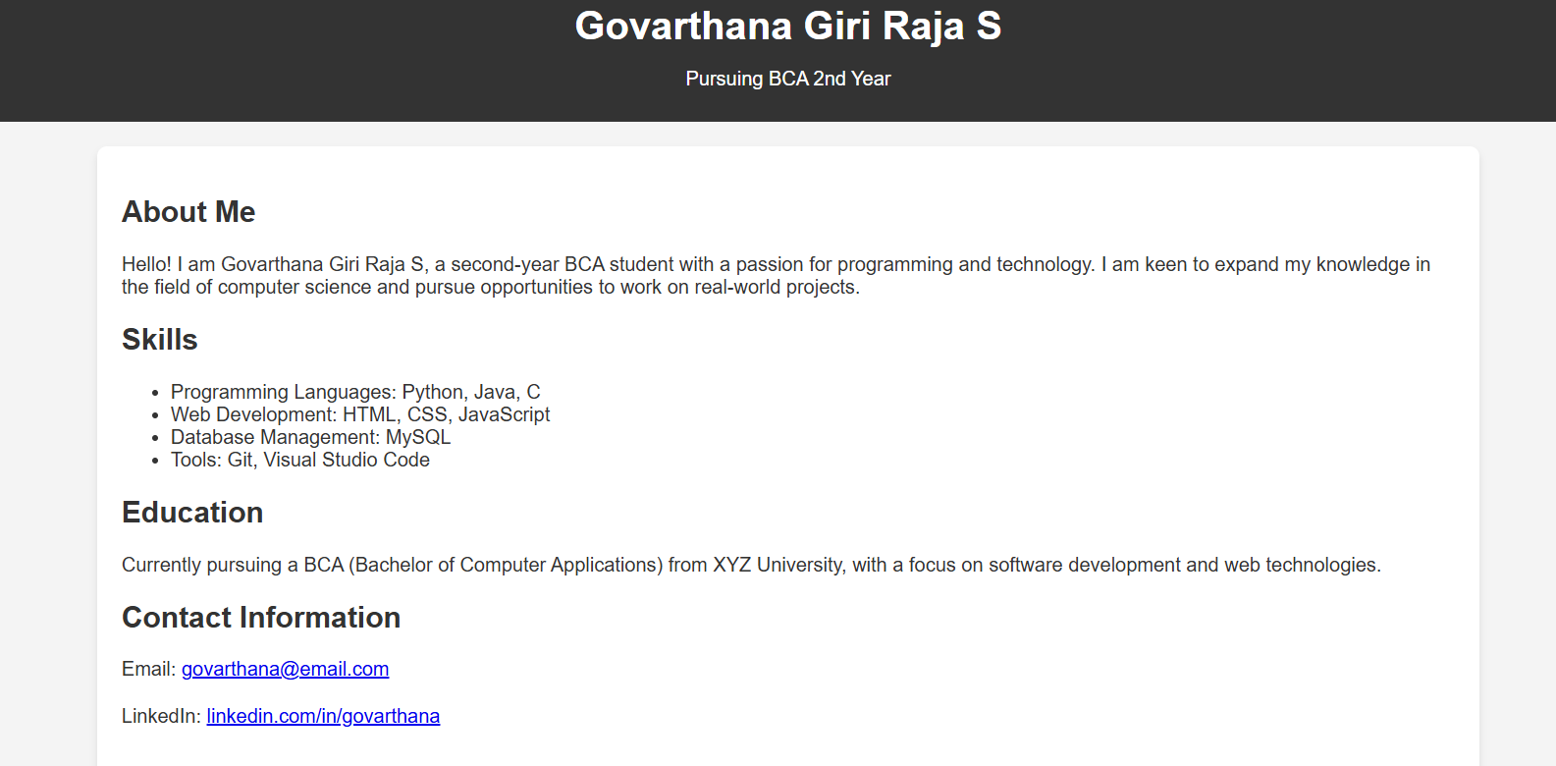

RESULTS AND SCREENSHOTS
3/21/2024 Annual Review
10

Slide 11
GitHub link
https://giri-9150.github.io/Giri-Raja/

Slide 12
CONCLUSION
improving a website’s authority, visibility, and ranking in search engines. Unlike On-Page SEO, which focuses only on internal elements, Off-Page SEO works externally to build credibility, trust, and popularity through backlinks, social engagement, and brand mentions.
By applying effective techniques such as link building, content marketing, influencer outreach, and reputation management, businesses can attract more targeted traffic, boost domain authority, and strengthen their brand image online.
In today’s competitive digital world, Off-Page SEO is not just about getting links but about building relationships, trust, and long-term authority. When combined with On-Page SEO and Technical SEO, it forms a complete strategy that ensures sustainable growth, better search rankings, and higher online success.
12

